Slide 1
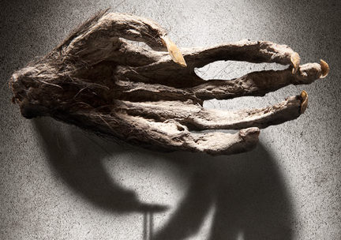
Monkey’s Paw Analysis
How does the setting of “The Monkey’s Paw” contribute to the atmosphere and mood?
In what way does the setting describe in lines 1-21 suggests or foreshadowing later events
Make an inference as to what Mr. White believes is on the other side of the door. How do you know?
What is the tone of this piece? Cite multiple examples of textual evidence that demonstrate tone.
How does the author establish suspense in the story? Cite multiple examples of textual evidence to support your claim and explain fully how EACH of these creates suspense.

