Slide 1
Economics
A Brief Summary of Concepts

Slide 2
Basic Econ VOCAB
Free Market System – producers and consumers act freely.
  United States is a free market economy
Producer – a person or business that supplies goods and services
Goods – items that people make and use
    Food, games, etc
Services – things people do for others.
    Medical services, teaching
Consumers – people and businesses that use goods and services to meet needs and wants.

Slide 3
Basic Econ VOCAB cont.
Consumption – the act of using goods and services
Profits – the money that producers make from goods or services
Price – the cost of a good or service
    The difference between the producer’s cost and the selling price is the profit.
      Example – A car company spends $12,000 to manufacturer a vehicle. They sell the car for $26,000. The profit is $14,000; this profit is split between many people.
Gross Domestic Product (GDP) – the value of all goods and services produced within a country in a single year.

Slide 4
Supply and Demand
Supply – The amount of goods and services that producers make.
Demand – The amount of items or services consumers are willing to buy.
  If many consumers want to buy a product, producers will make more of it because of the strong demand. If they do not produce more, the cost increases due to the high demand.
  If few consumers want to purchase the product producers will stop making the product.
Elasticity of Demand ADD THIS!!!

Slide 5
Wants
People’s wants are unlimited, but because of limited resources we cannot fulfill our unlimited wants
Economists refer to the inability of scarce resources to meet our unlimited wants as the problem of scarcity
Due to this problem of scarcity, every time we choose to satisfy one of our wants, we give up the chance to satisfy other wants. This trade-off is called opportunity cost.

Slide 6
Three basic economic questions
In deciding how to deal with the problem of scarcity, every society must answer three basic economic questions.
1. What should be produced?
2. How should it be produced?
3. Who should get what is produced?
How a society answers these three questions is known as its economic system.

Slide 7
Factors of production
The following are needed to produce goods or services. Without these production does not happen.
1. Natural Resources
2. Human Capital – Labor
3. Capital Equipment – ex. Machines
4. Entrepreneurs (form of human capital) – these are the people that combine the above three to create something.

Slide 8
Buying on credit
Individuals, businesses, and governments are sometimes able to borrow money to buy goods and services.
Borrower pays interest
This is known as buying on credit
  Common ways:
    Installment buying – loans
    Credit Card Purchases
Adds cost to the purchase

Slide 9
Forms of business organization
Single ownership – a business owned by one person or a family
Partnership – a business with two or more owners
Corporation – a business that includes investors (stockholders) that buy shares in the company. They are not directly involved in running the business, and are not personally liable for the company’s debts.

Slide 10
Levels of Economic activity
1st Level = Primary Industry – Uses natural resources to make money.
  Ex. Farmers harvest grain and sell it for food
2nd Level = Secondary Industry – Uses raw materials to produce or manufacture something new.
  Ex. Kellogg's purchases the grains and makes cereal
3rd Level = Tertiary Industry – Provide a service to people and businesses.
  Ex. The grocery store sells the Kellogg's cereals
4th Level = Quaternary Industry – Processes and distributes information
  Ex. Researchers test the quality of the cereal

Slide 11
Check up from the Head up
What is opportunity cost?
What are the three basic economic questions?
How a society answers these questions is known as what?
What is the difference between producers and consumers?
How is profit determined?
What is the driving force behind supply and demand?
What are two common ways of buying on credit?
What is a disadvantage of buying on credit?
What are the four factors of production?
What are the three forms of business organization?
What are the levels of economic activity – explain each briefly

Slide 12
Government and the Economy
The government acts like a police officer in the marketplace.
  Ensures people and businesses live by certain rules.
Gov’t supplies citizens with some goods and services.
    Schools, parks, roads
Goods and services provided by the gov’t are known as public goods and public services

Slide 13
Levels of Gov’t
Federal
  Prints money
  Collects national income taxes
  Pays for national defense
  Regulates Social Security
  Sets minimum wage

Slide 14
Levels of Gov’t cont.
State
  Collects state income taxes
  Pays for state highways, state courts, and prisons
  Give $ to local schools
Local
  Collects local sales taxes
  Collects property taxes
  Pays for local schools, police, parks, and services

Slide 15
Economy of Michigan
The location of the state has had a great influence on its econ. Development
Great Lakes
Iron Ore
Copper
Borders Canada, center for international trade

Slide 16
Role of international Trade
U.S. part of global economy
Global Interdependence - The dependence of trading with other countries
Import - to bring in goods from a foreign country. Importers are the people bringing in the goods
Export – Send goods to be sold in a foreign country. Exporters are the people shipping goods to a foreign country
Customs Duty – The special tax applied to goods imported into the country.

Slide 17
Quick Review:
Take out a sheet of paper and answer the following questions:
  What are Goods?
  What are Services?
  What are Resources?
  What is Scarcity?
  What three questions do countries need to answer?
  What do these questions determine?

Slide 18
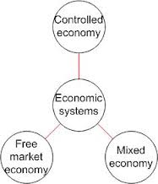
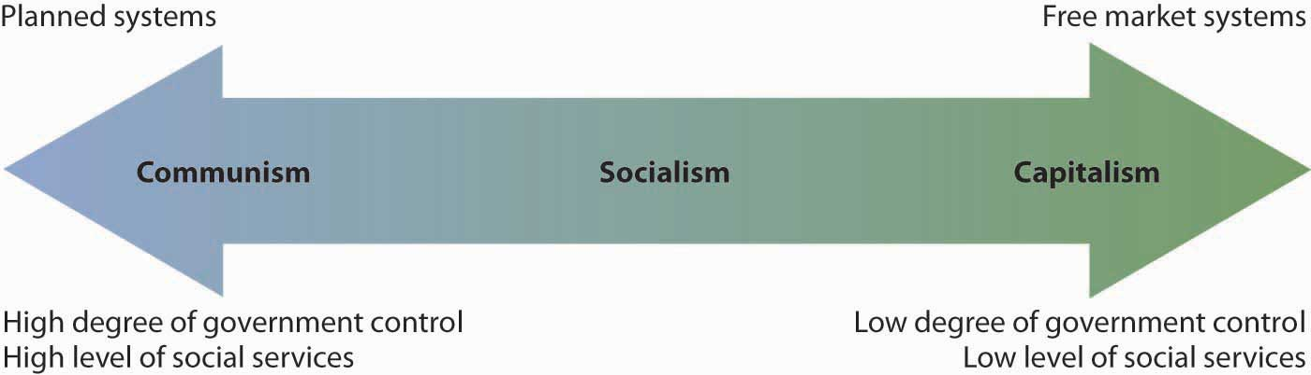
Economic Systems
How the Government influences how I make money.

Slide 19
Economic Systems
Def. The method used by a society to produce and distribute goods and services.
Or, How the government tells us what we can get and how to get it!

Slide 20
All Economic Systems Must Consider the Following Questions:
What goods and services to produce?
How will they produce them?
Who will get them?
Also MUST consider:
How much will they produce now, and how much later?
Each economic system answers these questions in a DIFFERENT WAY.

Slide 21
Types of Economic Systems
There are 3 basic types of economic systems.
Traditional
Command
Free Market
But are there really four types????

Slide 22
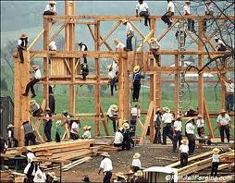
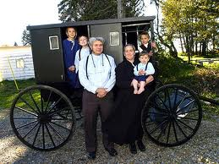
1. Traditional Economy
Economic questions are answered by habits and customs (the way it has always been done)
Children work the same jobs parents worked, often farming or hunter/gatherer
Fear Change!
Ex. Inuits, the Amish,
Pigmies, Bush People

Slide 23
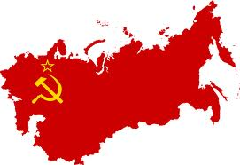
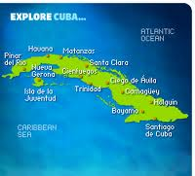
2. Command Economy
The government answers the basic economic questions
Advantages: able to act quickly in emergencies, provide for all people equally
Disadvantages: Inefficient, no incentive to work hard or be creative
Ex. Communist Countries (China, Vietnam, North Korea, former Soviet Union, Cuba)

Slide 24

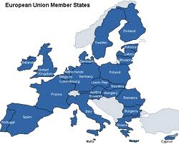
3. Free Market Economy
Economic questions are answered by individual buyers and sellers.
Supply and demand influence economy
People act out of self interest; motive for profit (money) drives the economy
Also known as FREE ENTERPRISE or CAPITALISM
Ex. The United States, Western Europe, Japan

Slide 25
I lied!
I said there were 3 types of economic systems, but there is a 4th!
Mixed Economy: No economy is pure market, pure command or pure traditional, elements of each appear in all economies, some have more elements of one economy than another.
Market Mixed Command
USA
Great Britain
China

Slide 26


American Mixed Economy
While the United States is mostly a free market economy, it does have elements of a command economy.

Slide 27



Features of American Free Market Economy
1. Economic Freedom: individuals have the right to choose
2. Competition: more than one producer of good/services insures choice
3. Private Property: individuals have the right to own their own property, including business

Slide 28


Features of American Free Market Economy (cont)
Self-Interest: individuals make
decisions based on what is best for them
Voluntary Exchange: individuals may freely buy and sell goods
Profit Motive: individuals are driven by a desire to profit (make money)

Slide 29
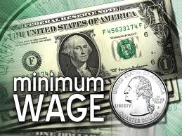


Features of American Command Economy
Government regulation of some business practices
  Ex. Wages, labor hours,
  safety practice.
Government limits certain choices
  Ex. Cannot buy or produce certain goods/services
Government provides aid to the needy
  Ex. Medicare, Medicaid, welfare

Slide 30
The Circular Flow Model
How Things Work in a
Mixed-Market Economic System

Slide 31
Circular Flow Model
The circular flow of income is an economic model depicting how money flows through the economy.
In this model - producers are termed as "firms" while consumers are referred to as "households."
Firms supply goods and services while households consume these goods and services.
Money flows to workers in the form of wages
THEN money flows back to firms in exchange for products.

Slide 32
In our economic system there are two sectors:
the household sector & the business sector (firms)

Slide 33
Households
Demand consumer goods, like: cars, computers, washers, lawnmowers, etc.
Households provide labor resources to business and own most of the resources of production

Slide 34
Businesses/Firms
Produce and supply goods and services
Businesses demand resources for production: land, labor, capital, and entrepreneurs

Slide 35
These two sectors interact in two markets:
the Product Market and the Factor Market

Slide 36
Product Markets
are the markets where households acquire finished (consumer) goods & services.
The markets we are most familiar with are retail markets.
Examples include: Wal-Mart, gas stations, Burger King, Best Buy, the dentist.

Slide 37
Factor Markets
are the markets where business acquire the factors of production (land, labor, capital..)
When you are looking for a job you are in the factor (labor) market.
Examples include: Cowan Equipment, IBM Business Solutions, Snelling Personnel

Slide 38
Product
Markets
Businesses produce goods and provide
services in the product market.
In exchange households pay for goods &
services with consumption expenditures
(money)
Factor/Resource
Markets

Slide 39
Product
Markets
Households provide labor, own land,
invest in capital and have the talent
businesses need to produce goods and
services. Sell Resources.
Firms buy resources. To pay for these resources business pay wages and salaries, pay rent, purchase raw material, pay dividends to households.
Factor/Resource
Markets
Factor
Markets

Slide 40
goods & services…
Product
Markets
….goods & services
….consumption spending….
….salaries, wages, rent, dividends…..
Factor/Resource
Markets
Factor
Markets
land, labor, capital……
…entrepreneurial ability

Slide 41
goods & services…
Product
Markets
….goods & services
….consumption spending….
In a mixed economy its not always this
simple, something is missing.
The Government
….salaries, wages, rent, dividends…..
Factor/Resource
Markets
Factor
Markets
land, labor, capital……
…entrepreneurial ability

Slide 42
Governments
Federal, State, & Local
Governments require resources to provide services
To purchase these resources governments collect taxes
Government spending makes up 20% of GDP

Slide 43
goods & services…
Product
Markets
….goods & services
….consumption spending….
The Government
….salaries, wages, rent, dividends…..
Factor/Resource
Markets
Factor
Markets
land, labor, capital……
…entrepreneurial ability

Slide 44
goods & services…
Product
Markets
….goods & services
….consumption spending….
Personal Income Taxes
Corporate Income Taxes
….salaries, wages, rent, dividends…..
Factor
Markets
land, labor, capital……
…entrepreneurial ability

Slide 45
goods & services…
Product
Markets
….goods & services
….consumption spending….
Personal Income Taxes
Goods & Services
Gov’t Spending
Welfare
Subsidies
Public Services
Public Services
Corporate Income Taxes
Gov’t Spending
Resources
….salaries, wages, rent, dividends…..
Factor/Resource
Markets
Factor
Markets
land, labor, capital……
…entrepreneurial ability

Slide 46
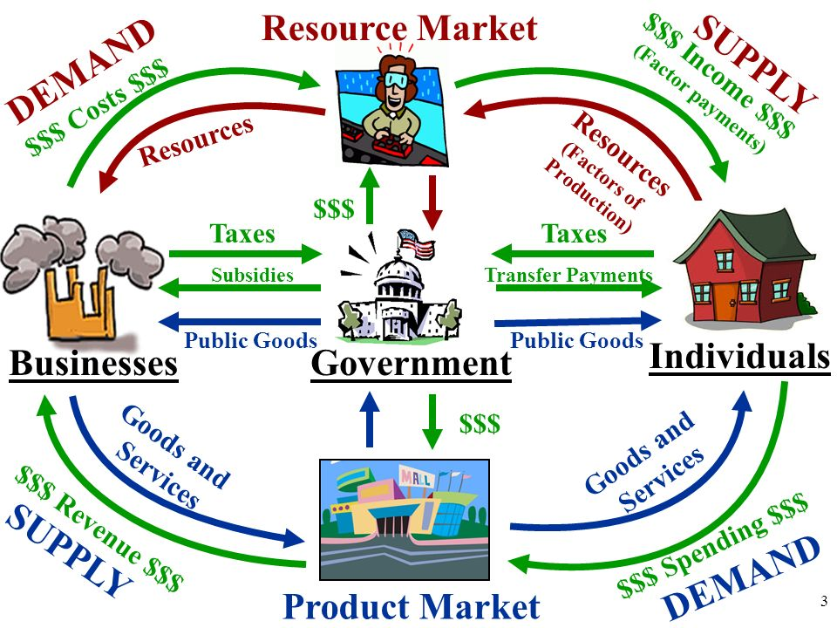
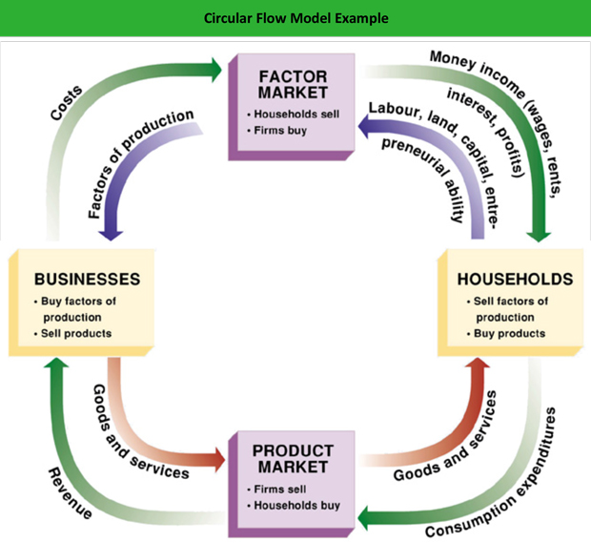
Circular Flow Model - Chart

Slide 47
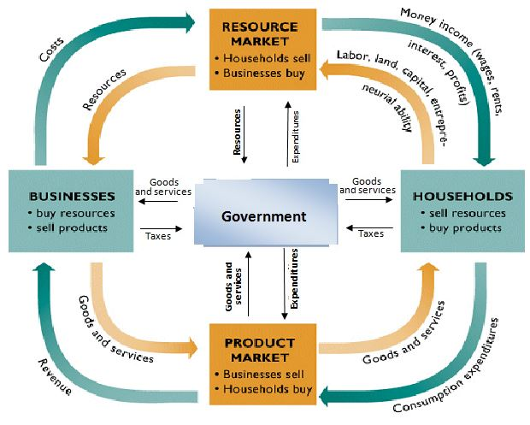

Slide 48
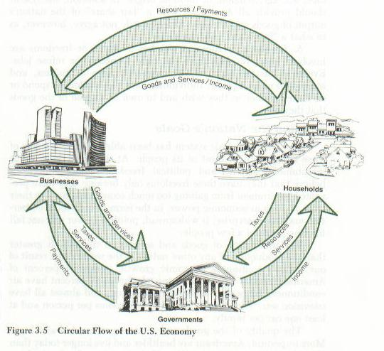

Slide 49
Short Videos explaining circular Flow Model
Circular Flow Model Video
Circular Flow Model Matrix

