Slide 1
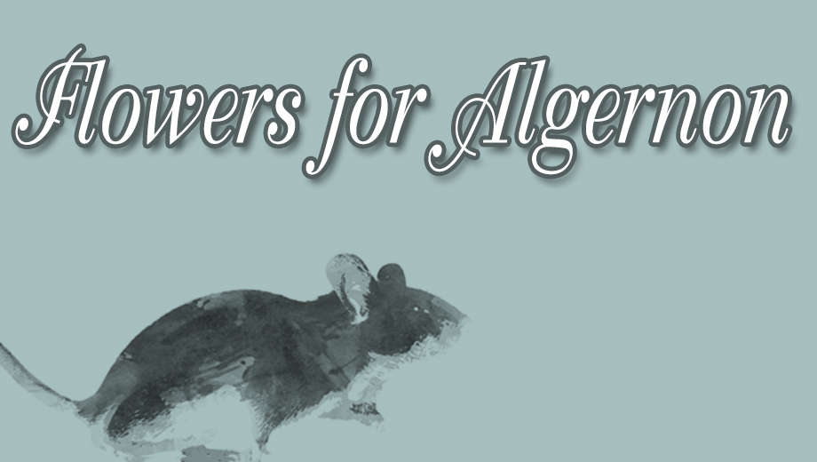
Analyzing Flowers for Algernon

Slide 2
Theme Ideas Themes are the fundamental and often universal ideas explored in a literary work.
Man playing the role of God
Friendship and its implications
Role of intelligence
Mistreatment of the mentally disabled
Tension between intellect and emotion

Slide 3
Motif Ideas Motifs are recurring structures, contrasts, or literary devices that can help to develop and inform the text’s major themes.
Changes in grammar and literacy
Flashbacks and the tension it creates
Science vs nature
Darkness vs. Light

Slide 4
Symbol Ideas – Symbols are objects, characters, figures, or colors used to represent abstract ideas or concepts.
Algernon
Flowers
Rorschach Test
Cages
Mazes
Progress Reports

Slide 5
Allegory Idea – a story, poem, or picture that can be interpreted to reveal a hidden meaning, typically a moral or political one.
Concept of Adam and Eve
Related to Plato’s “Allegory of the Cave” (you would have to research this one).

